Slide 2

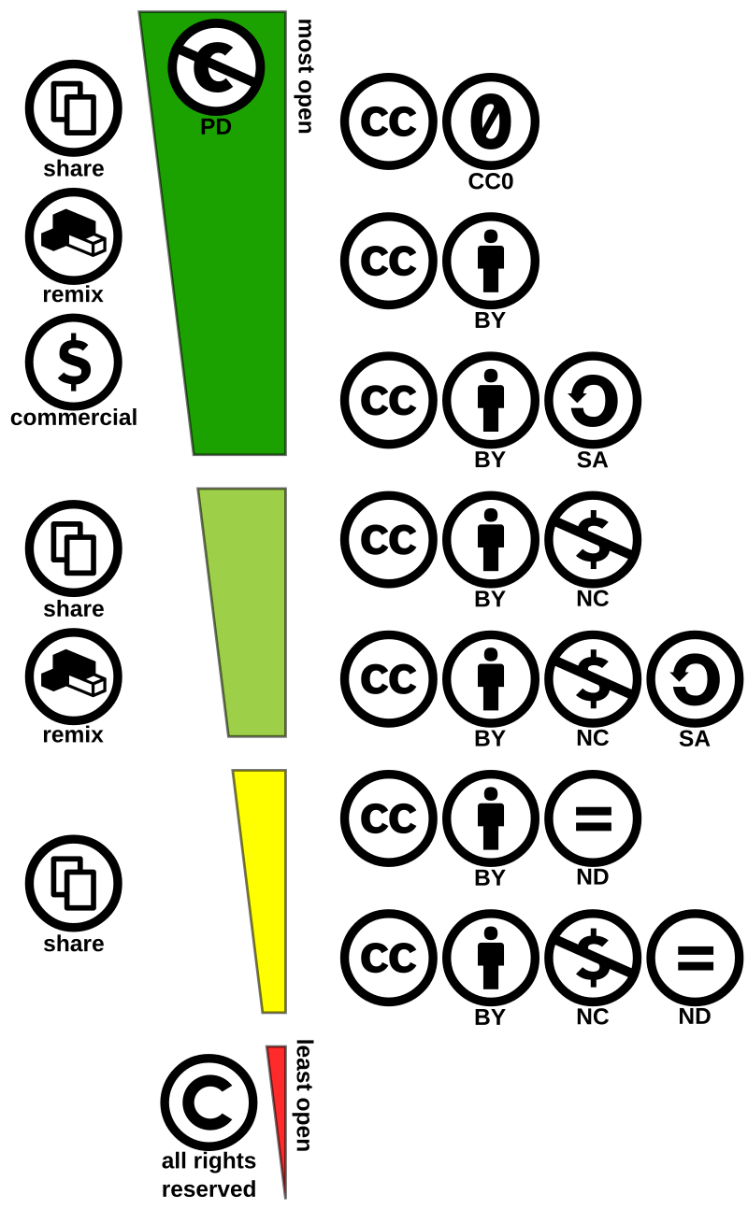
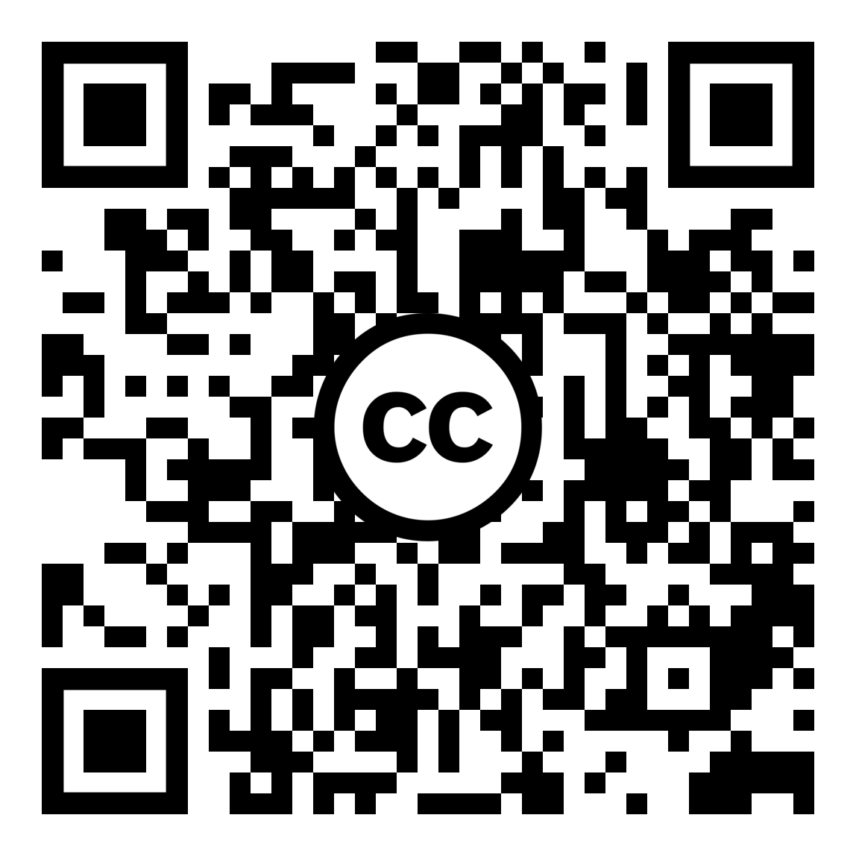

music
some rights reserved
Open, standardized licenses for sharing copyrighted music
Creators retain copyright while granting usage rights
Allows for remixing, sharing, and adapting (with conditions)
“my problem isn’t piracy, it’s obscurity”
― Cory Doctorow, Author
To learn more go to: friendsofccmusic.org/learn-more
By Shaddim; original CC license symbols by Creative Commons - https://creativecommons.org/about/downloads/https://creativecommons.org/policies/Original CC license icons licensed under CC BY 4.0, CC BY 4.0, https://commons.wikimedia.org/w/index.php?curid=47247325

Slide 3
Creative Commons
“Some Rights Reserved”
Open, standardized licenses for sharing copyrighted music
Creators retain copyright while granting usage rights
Allows for remixing, sharing, and adapting (with conditions)
“my problem isn’t piracy, it’s obscurity”
― Cory Doctorow, Author
To learn more go to: friendsofccmusic.org/learn-more
By Shaddim; original CC license symbols by Creative Commons - https://creativecommons.org/about/downloads/https://creativecommons.org/policies/Original CC license icons licensed under CC BY 4.0, CC BY 4.0, https://commons.wikimedia.org/w/index.php?curid=47247325

Slide 4
Creative Commons
“Some Rights Reserved”
Versus
Standard Copyright
“All Rights Reserved”
What is it?
Open, standardized licenses for sharing copyrighted music
Creators retain copyright while granting usage rights
Allows for remixing, sharing, and adapting (with conditions)
To learn more goto: Landing Page
“my problem isn’t piracy, it’s obscurity”
― Cory Doctorow, Author
By Shaddim; original CC license symbols by Creative Commons - https://creativecommons.org/about/downloads/https://creativecommons.org/policies/Original CC license icons licensed under CC BY 4.0, CC BY 4.0, https://commons.wikimedia.org/w/index.php?curid=47247325

Slide 5
Common Combinations
CC BY: Most flexible, allows commercial use.
CC BY-SA: ShareAlike, allows commercial use.
CC BY-NC: Non-commercial, allows adaptations.
CC BY-ND: No changes, allows commercial use.
CC BY-NC-SA: Non-commercial, ShareAlike.
CC BY-NC-ND: Most restrictive, non-commercial, no changes.
Where to Find Music
Free Music Archive
ccMixter
SoundCloud (search "Creative Commons")
Bandcamp
Netlabelguide.com
Jamendo
License Types
Attribution (BY): Always credit the creator.
ShareAlike (SA): Share new creations under the same license.
NonCommercial (NC): Non-commercial use only.
NoDerivatives (ND): No changes allowed.
Important!
Check the license! Each work has specific terms.
Give credit! Include creator, title, license, and source link.
Moral rights: Creators retain rights even with CC license.

